Slide 1
SUDOKU MASTER
Aaron, Brad, Emily, Julian, Till

Slide 2
Sudoku
Sudoku is a classic puzzle game normally played with pencil and paper. This software provides a digital interface which allows users to play Sudoku, import their own Sudoku boards to play, and even create their own boards.

Slide 3
Background
There are a variety of web-based applications available to simulate a game of Sudoku. Some use premade Sudoku boards, while others are able to generate them. Sudoku Master is capable of generating brand new Sudoku boards as well as saving created boards to be played again. There are a variety of different options to choose from and different aesthetically backgrounds.

Slide 4
Devices and Specifications
Requires Windows or MacOS and JAVA.
Languages: English

Slide 5
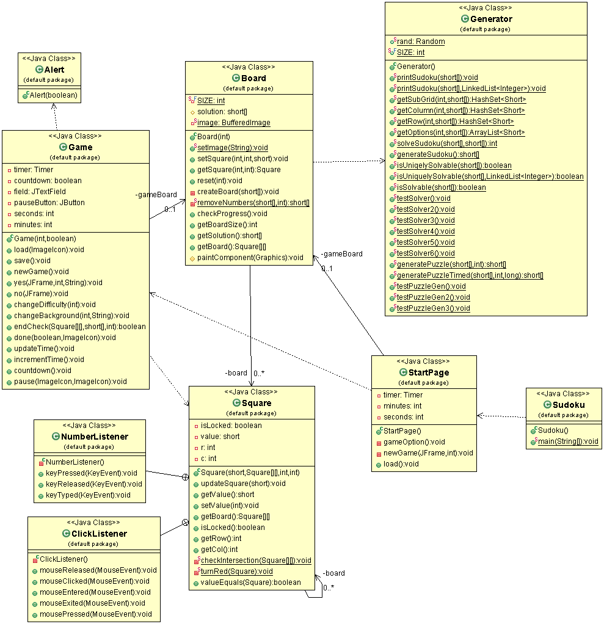
Class Diagram

